Slide 1

Optimising Spark for Large-Scale Data Processing

Slide 2


Course: Data Engineering - II
Lecture On: Optimising Spark Clusters
Instructor: Vishwa Mohan

Slide 3
WHY TO OPTIMIZE CLUSTER UTILIZATION?
We need to optimize these parameters
Cluster resources are aligned with the job requirements Example:
If it’s failing due to an OOM issue, increase the Driver Memory
If it’s failing on executors, increase the Executor Memory
Increase the no. of Executor cores to increase parallelisation.
Driver Memory
Executor Memory
Executor Cores

Slide 4
COMMON MISTAKES
01
Driver memory is too low -> OOM issue
Driver memory is too high -> Wastage of Resources
02
Too many executor cores -> Wastage of resources
05
Executor memory is too less -> OOM issue
03
No. of partitions < No. of executor cores -> Wastage of Resources
06
Executor memory is too high -> Wastage of Resources
04
No. of partitions is too high -> Stress on Driver Node
07

Slide 5
HOW TO IMPROVE CLUSTER UTILIZATION?
01
Decide the size of the Driver and Executor memory based on the size of the job’s data
02
Choose the right configuration and size of cluster depending on the appropriate Cost - Performance tradeoff
03
Start with the default configuration and then experiment with CPU and memory parameters to optimize the performance

Slide 6
LOCAL MODE (PSEUDO CLUSTER)
Non-distributed single-JVM deployment mode where all the components run on a single instance
Generally used for testing, debugging and demonstration purpose
Parallelism is defined by specifying the number of CPU cores which can be used for execution
spark = SparkSession.builder.appName('demo').master("local").getOrCreate()

Slide 7
STANDALONE MODE
Uses the inbuilt Spark Resource Manager
In this mode, Spark allows us to create a distributed Master-Slave architecture
It uses a single node cluster configuration by default
spark-submit --master spark://207.184.161.138:7077

Slide 8
SPARK DEPLOYMENT MODES
Driver Program
Spark Cluster Mode
Worker Node inside the cluster
Spark Client Mode
External Client machine

Slide 9
SPARK DEPLOYMENT IN YARN
If Apache YARN is used as Resource Manager
YARN Client Mode
YARN Cluster Mode

Slide 10
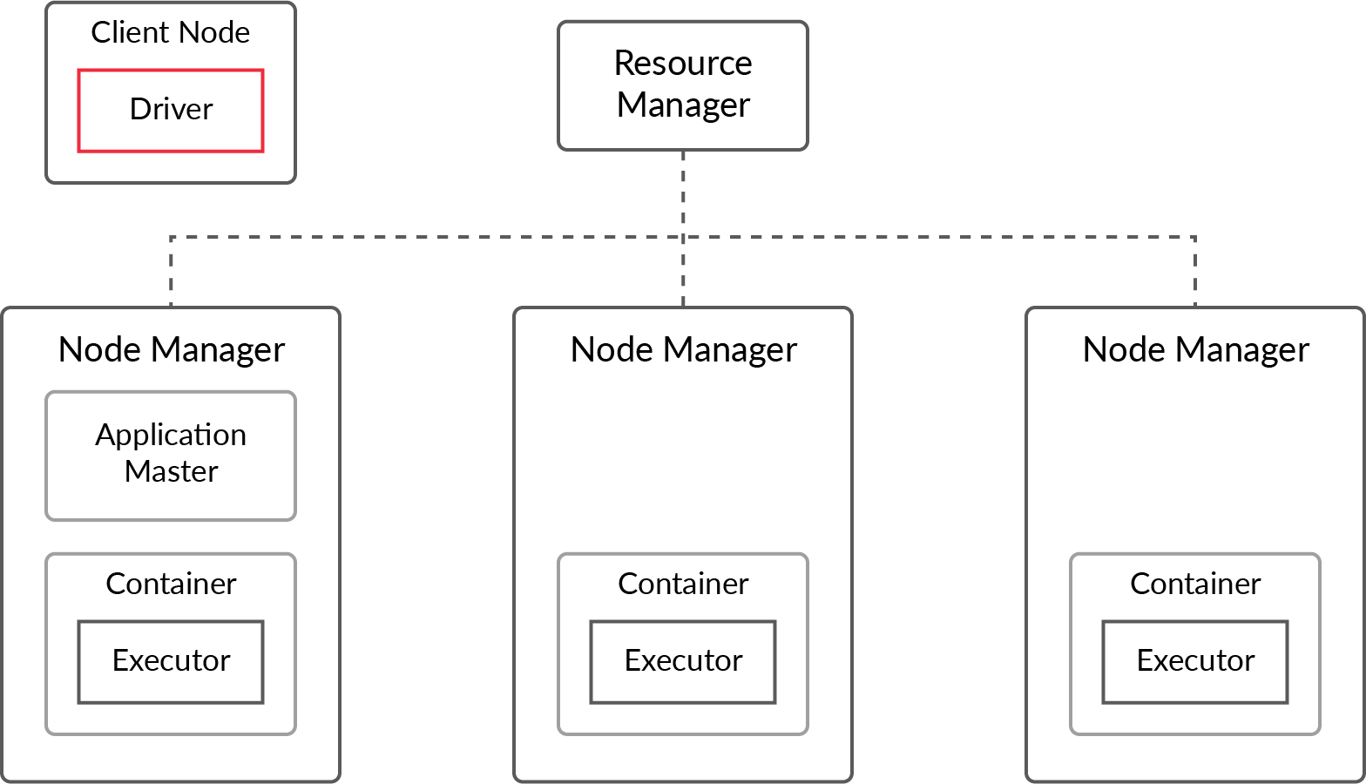
YARN CLIENT MODE

Slide 11
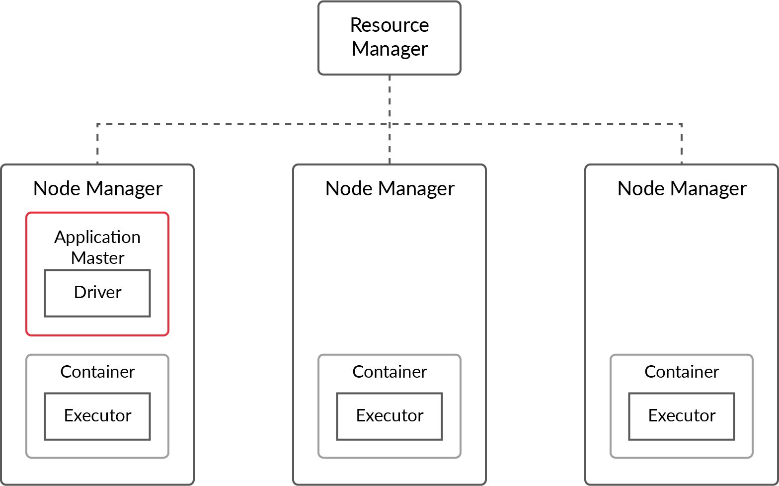
YARN CLUSTER MODE

Slide 12
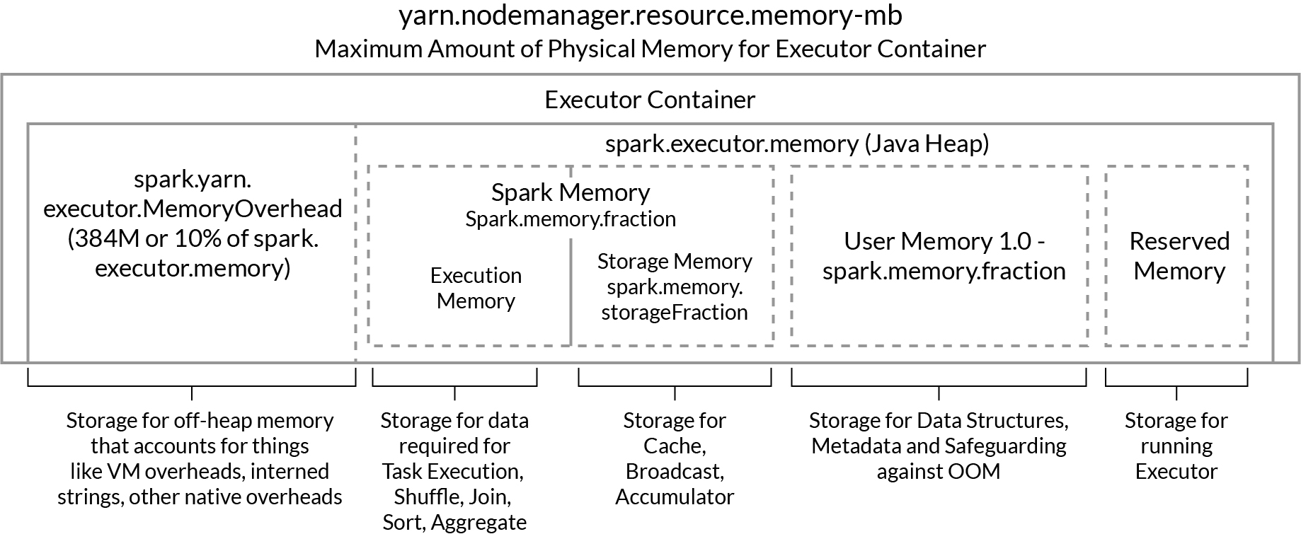
TUNING SPARK MEMORY AND CPU PARAMETERS

Slide 13
TUNING SPARK MEMORY AND CPU PARAMETERS
There are various configuration parameters which we need to set carefully for optimal performance
Some of them are as follows -
spark.executor.memory – Size of memory to use for each executor that runs the task
spark.executor.cores – Number of virtual cores
spark.driver.memory – Size of memory to use for the driver
spark.driver.cores – Number of virtual cores to use for the driver
spark.executor.instances ­– Number of executors. To be set unless spark.dynamicAllocation.enabled is set to true.
spark.default.parallelism – Default number of partitions in RDDs returned by transformations like join, reduceByKey, and parallelize when no partition number is set by the user

Slide 14
SPARK JOB IN PRODUCTION ENVIRONMENT
01
Version control of the Spark job
02
CI - CD Pipeline Setup
03
With each successful build, complete Spark Job is bundled/packaged
Hook for on-demand execution of Spark Job or a Scheduler for the Spark Job is setup
05
Pipeline is set for the easy deployment of Spark Job
04

Slide 15
BEST PRACTISES WHILE WORKING WITH SPARK
01
Different workload has different processing patterns. Knowing the processing pattern will give the right direction to managing resources and time optimally
02
No one rule can fit all situations. Start from default config and then monitor to tweak and get better results.
Configure the cluster gradually based on the performance
03
Prefer smaller tasks over bigger tasks
05
Make sure that you fully utilize the parallel processing capabilities of your Spark Cluster
04
Don’t use all the resources. Leave some resources for the rest of the services and the system
06

Slide 16
BEST PRACTISES WHILE WORKING WITH SPARK
Common Error and Solution Approaches while working with Apache Spark
Driver OOM - Increase the Driver Memory
Executor OOM - Increase the Executor Memory
Too big Shuffle block - Keep the tasks small
Frequent GC - Keep the tasks small
Spark Resource - Spark Official Documentation

